Slide 1
Computer Organization and Architecture (BESE-15a)
Lecture 11
Dr. Hammad Afzal
23rd Nov, 2010

Slide 2
Cache Memory Chapter 4 of William Stallings's

Slide 3
Memory Characteristics
Location
Capacity
Unit of transfer
Access method
Performance
Physical type
Physical characteristics
Organisation

Slide 4
Location
CPU
Internal
A notion based on distance from processor.
Registers, Cache Memory, Main Memory
External
Disk-accessible via I/O controllers

Slide 5
Memory Characteristics
Location
Capacity
Unit of transfer
Access method
Performance
Physical type
Physical characteristics
Organisation

Slide 6
Capacity
For internal memory:
Bytes or words.
Word
8, 16 or 32 bits
The natural unit of organisation
For external memory
Bytes

Slide 7
Memory Characteristics
Location
Capacity
Unit of transfer
Access method
Performance
Physical type
Physical characteristics
Organisation

Slide 8
Unit of Transfer and related concepts
Internal
Usually governed by data bus width, i.e. Number of data lines into and out of memory module.
May be equal to word length, but often larger such as 64, 128 or 256 bits
Word
Natural unit of organization of memory.
Typically equal to number of bits used to represent integer and to instruction length.
Unfortunately, many exceptions
Addressable unit
Smallest location which can be uniquely addressed
Word, but often bytes
Length in bits A of an address and number of addressable units hold relationship 2^{A}=N
Unit of Transfer
Need not equal to word or an addressable unit.

Slide 9
Unit of Transfer and related concepts
External
Usually a block which is much larger than a word

Slide 10
Memory Characteristics
Location
Capacity
Unit of transfer
Access method
Performance
Physical type
Physical characteristics
Organisation

Slide 11
Access Methods (1) (Later after Ch6)
Sequential access
Units of data called records.
Access made in sequence.
Stored addressing information is used to separate records and assist in retrieval process.
Start at the beginning and read through in order
Access time depends on location of data and previous location
e.g. Tape (Chapter 6)
Direct access
Individual blocks or records have unique address based on physical location.
Direct access to general vicinity plus sequential search.
Access time depends on location and previous location
e.g. Disk (Chapter 6)

Slide 12
Access Methods (2)
Random access
Each addressable location in memory has a unique, physically wired-in addressing mechanism.
Access time is independent of location or previous access
e.g. RAM and some cache systems
Associative
Type of random access that make a comparison of desired bit locations within a word for a specified match, and is done to all words simultaneously.
Word is retrieved based on portion of its contents
Access time is independent of location or previous access, just like random access
e.g. Some cache systems

Slide 13
Memory Characteristics
Location
Capacity
Unit of transfer
Access method
Performance
Physical type
Physical characteristics
Organisation

Slide 14
Performance Parameters
Access time (latency)
For RAM, time to perform read or write, i.e, time between presenting the address and getting the valid data or storing the data.
(the overhead of finding the right place for the memory access and preparing to access it)
Memory Cycle time
Time may be required for the memory to “recover” before next access
Access time + additional time required before a second access can commence.
E.g. Time to regenerate data if they are read destructively

Slide 15
Performance Parameters
Transfer Rate
Rate at which data can be transferred into or out of memory.
For RAM, it is equal to 1/(cycle time).
For non-RAM, the following relationship holds
T_{N} = T_{A} + N/R
Where
TN = Average time to read or write N bits
TA = Average access time.
N = Number of bits
R = Transfer rate, in bits per second (bps)

Slide 16
Memory Characteristics
Location
Capacity
Unit of transfer
Access method
Performance
Physical type
Physical characteristics
Organisation

Slide 17
Physical Characteristics
Just an introduction, no details in scope.
Semiconductor
RAM
Magnetic
Disk & Tape
Optical
CD & DVD

Slide 18
Physical Characteristics
Decay
Volatility
Volatile vs non-volatile
Erasable
Non-erasable memory e.g. ROM
Of-necessity, non-erasable memory must be non-volatile.
Power consumption

Slide 19
Memory Characteristics
Location
Capacity
Unit of transfer
Access method
Performance
Physical type
Physical characteristics
Organisation

Slide 20
Memory Hierarchy: Design Decision
How much?
Capacity
How fast?
How expensive?
Trade-off between cost, capacity and access time

Slide 21
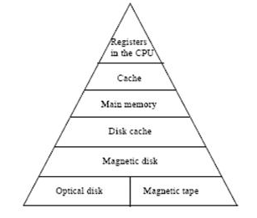
Memory Hierarchy - Diagram

Slide 22
Memory Hierarchy
Registers
In CPU
Internal or Main memory
May include one or more levels of cache
“RAM”
External memory
Backing store

Slide 23
Memory Hierarchy
Decreasing cost per bit.
Increasing capacity.
Increasing access time.
Decreasing frequency of access of the memory by the processor

Slide 24
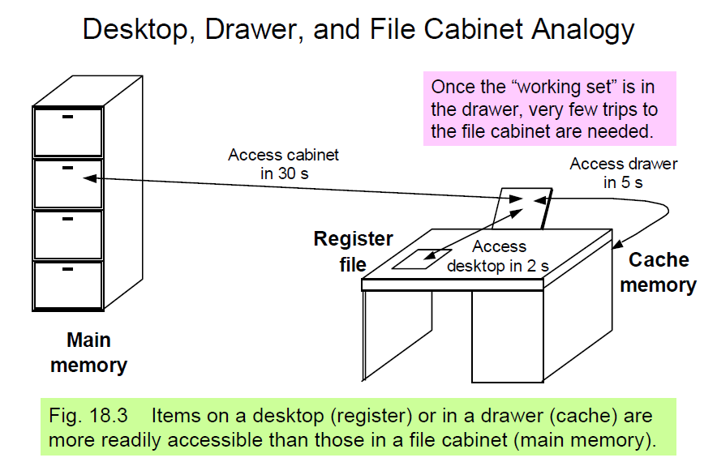

Slide 25
Hierarchy List
Registers
L1 Cache
L2 Cache
Main memory
Disk cache*
Disk
Optical

Slide 26
Locality of Reference
During the course of the execution of a program, memory references tend to cluster
For instance, repeated references to a small set of instructions,
e.g, loops, sub-routines, arrays
Organize data across hierarchy such that percentage of accesses to each successively lower level is substantially less than that of the level above
Consider two-level memory. Level-1 being faster and Level-2 being slower.
The current cluster (data and instructions) should be put in level 1.

Slide 27
Common Predictable Patterns
Two predictable properties of memory references:
Temporal Locality: If a location is referenced it is likely to be referenced again in the near future.
Spatial Locality: If a location is referenced it is likely that locations near it will be referenced in the near future.

Slide 28
Caches
Caches exploit both types of predictability:
Exploit temporal locality by remembering the contents of recently accessed locations.
Exploit spatial locality by fetching blocks of data around recently accessed locations.

Slide 29
Cache
Small amount of fast memory
Sits between normal main memory and CPU
May be located on CPU chip or module
Level 1 cache
Level 2 cache
Not visible to programmer or to the processor.

Slide 30
Misc Concepts related to Cache
Hit.
Miss
Hit-ratio
Fraction of all memory accesses that are found in the faster memory (e.g. the cache)

Slide 31
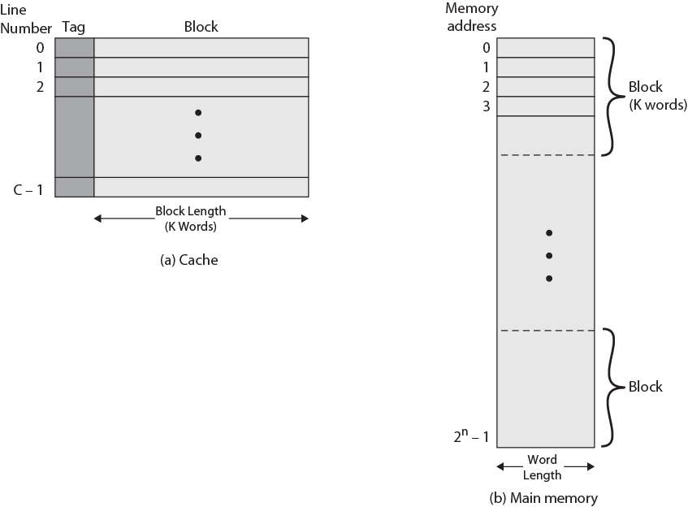
Cache/Main Memory Structure

Slide 32
Cache and Main Memory
Memory consists of number of fixed-length blocks of K words.
M=2^{n}/K blocks
Cache consists of C lines.
Each line contains K words + a tag.
Line size = Number of words in a line.
Number of lines is less than number of main memory blocks (C<<M)

Slide 33
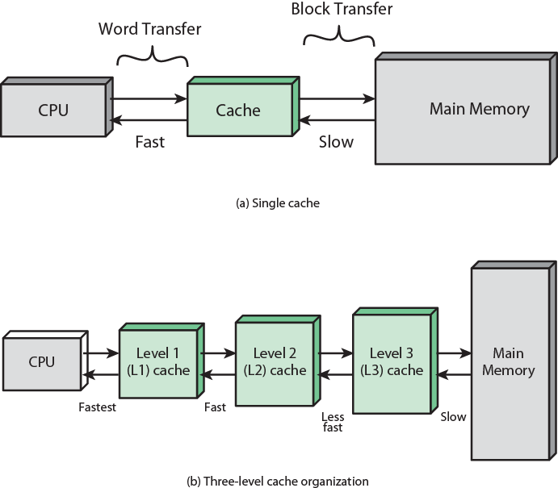
Cache and Main Memory

Slide 34
Cache operation – overview
CPU requests contents of memory location
Check cache for this data
If present, get from cache (fast)
If not present, read required block from main memory to cache (due to locality of reference principle)
Then deliver from cache to CPU
Tags
As number of blocks is more than number of lines, cache lines can not be dedicated to blocks. Therefore, cache includes tags to identify which block of main memory is in each cache slot.
The tag is usually a portion of main memory address

Slide 35
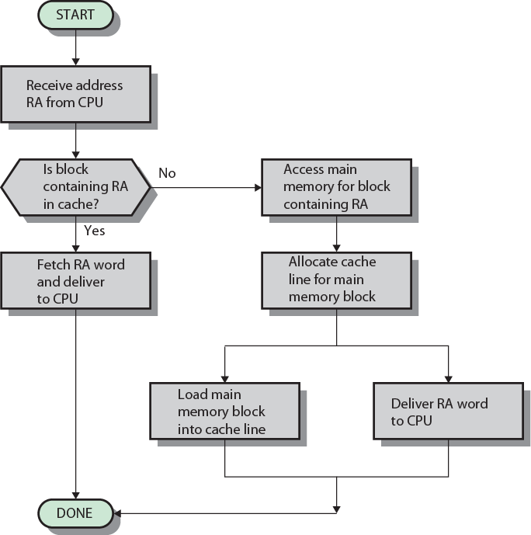
Cache Read Operation - Flowchart

Slide 36
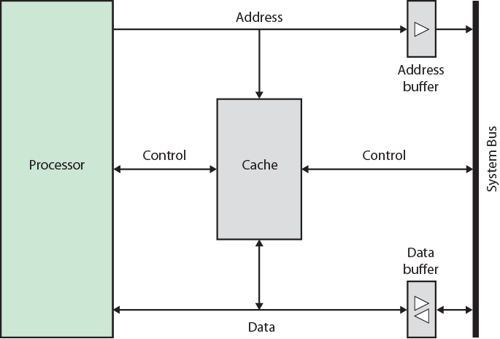
Typical Cache Organization

